Slide 1
Welcome to Inventory Management System
Using Java Swing and JDBC technology

Slide 2
Project Goals and Target
Inventory management system is a sales and purchased based business management technology in which an admin or owner can have full control to add or delete a salesman, a admin. Can purchase product and can sale also. He can view the dashboard in which complete sales or purchase story shown as a summery. Can view the report files.
In the system there another actor is salesman who can only sale products and can view the sales summery only.
The system has automatic technology to calculate the amount of sales and purchase of a day, a month or a year.

Slide 3
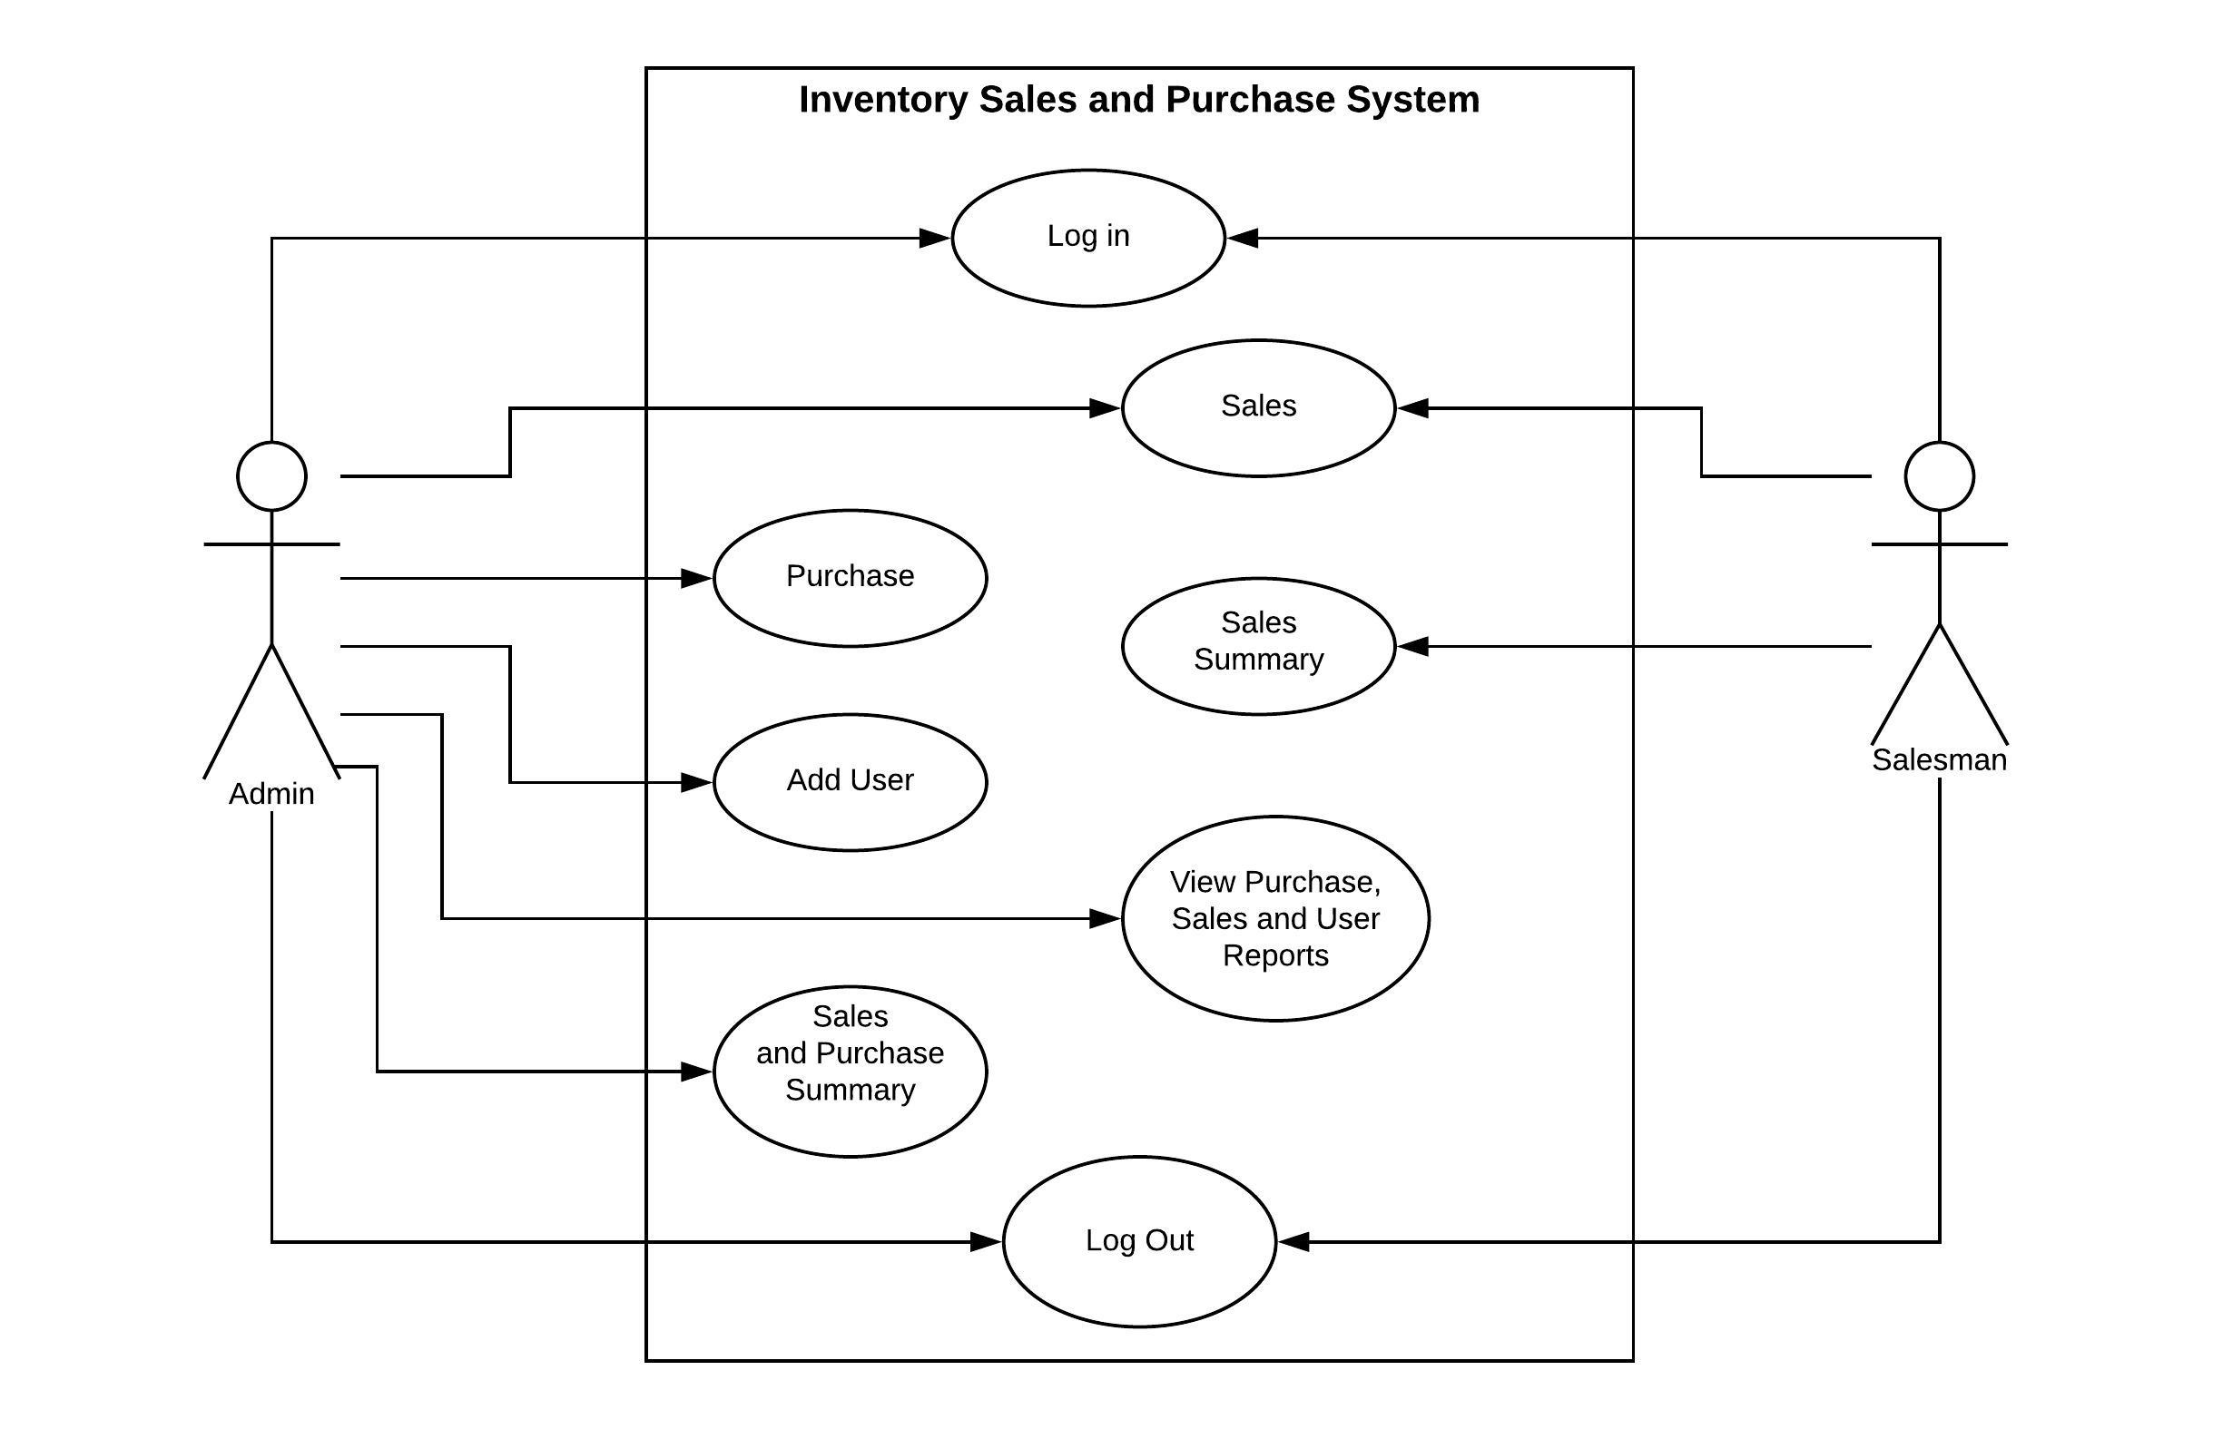
Use case diagram of the system.

Slide 4
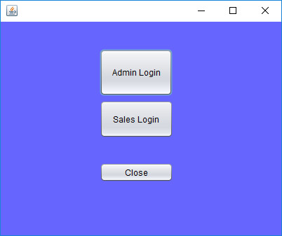
Working procedure of the system.
By opening the main window it appears the login section of admin or salesman like below.

Slide 5
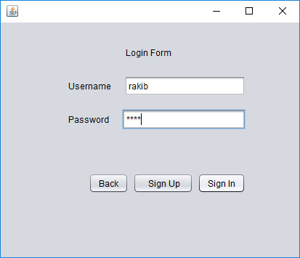
Continue…
Log in window…

Slide 6
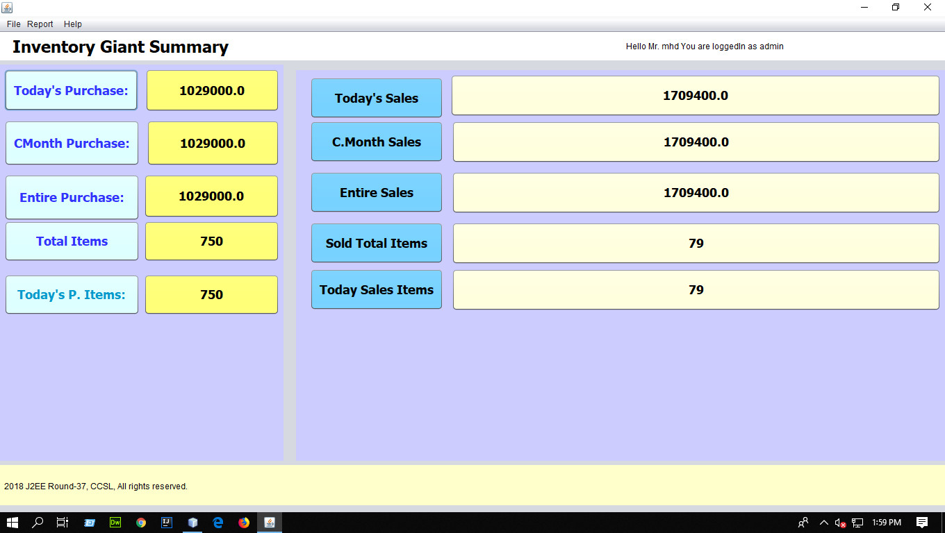
Continue…
Selecting any option one can log into the system either an admin or a salesman. Here firstly we logged in as an admin. It will redirect to the Summary page.

Slide 7

Continue…
Form the menu bar admin can select option from file menu to go to dashboard, summery, category, sales or purchase or add user page.

Slide 8
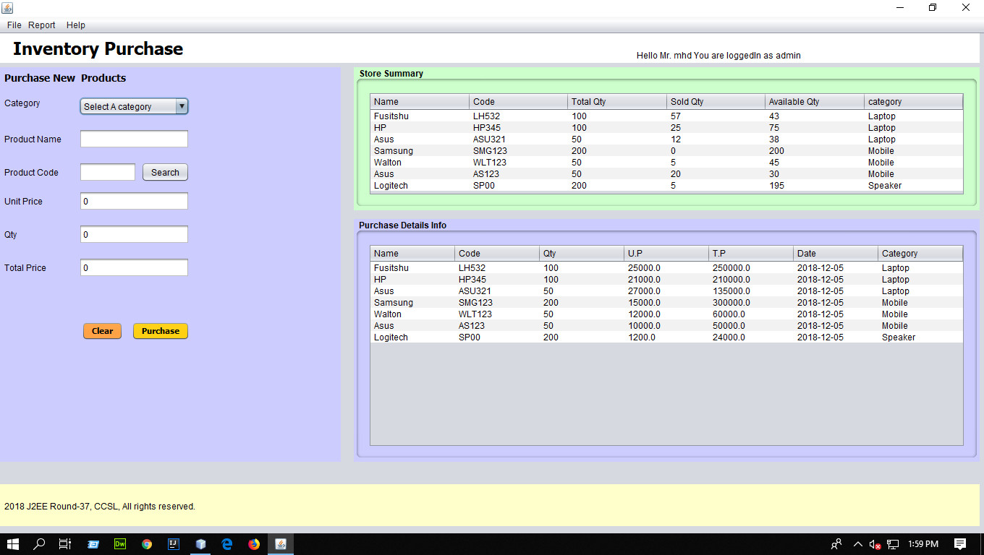
Continue…
Purchase view for admin..

Slide 9
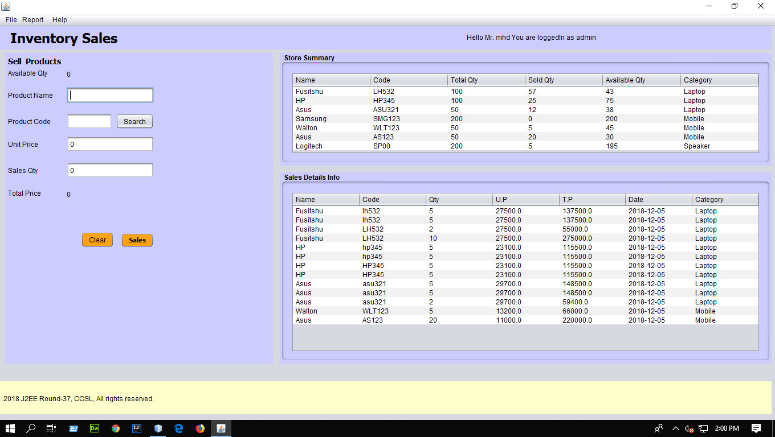
Continue…
Sales view for admin

Slide 10
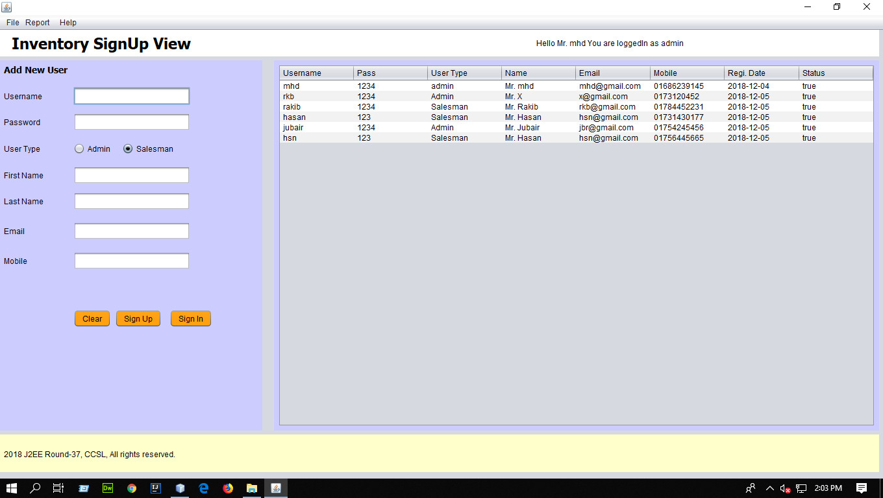
Continue…
Add user or sing up view for admin…

Slide 11
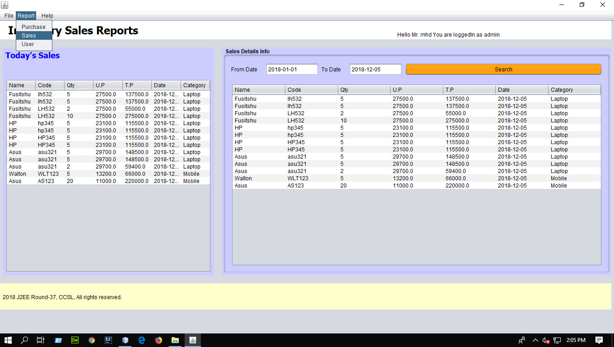
Continue…
From the menu tab user can select report menu to see the sales , purchase or user report. Here we select sales report of admin

Slide 12
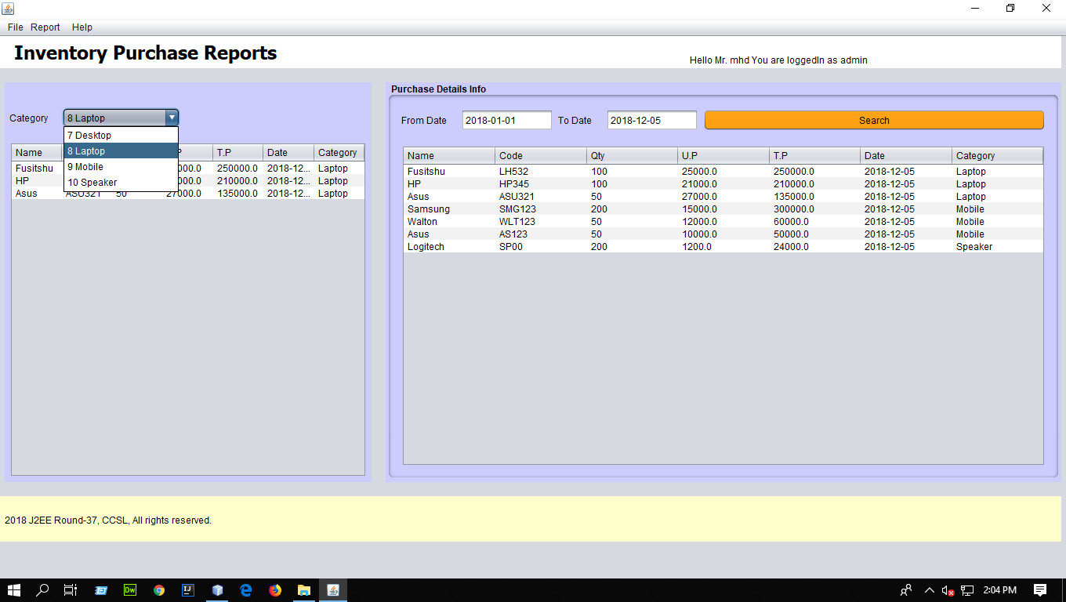
Continue…
Purchase report for admin

Slide 13
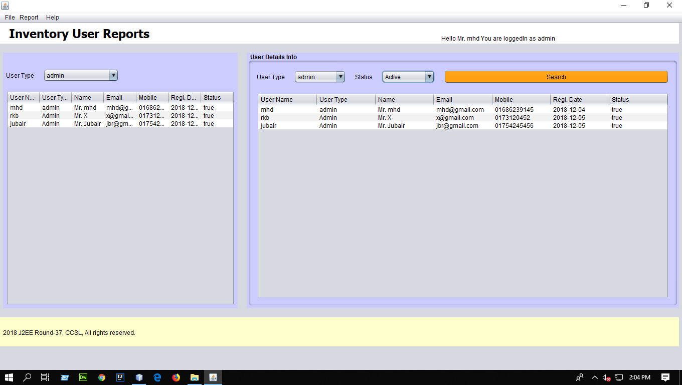
Continue…
User report for admin

Slide 14
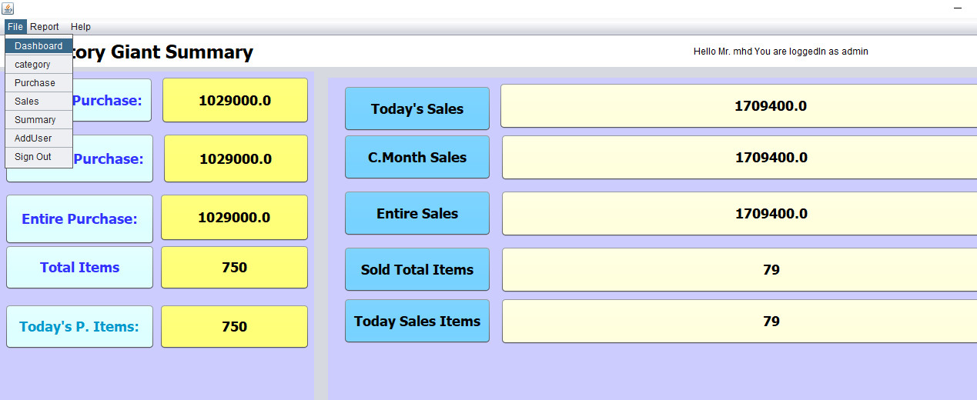
Continue…
Sign out from menu tab will redirect user to the login window

Slide 15
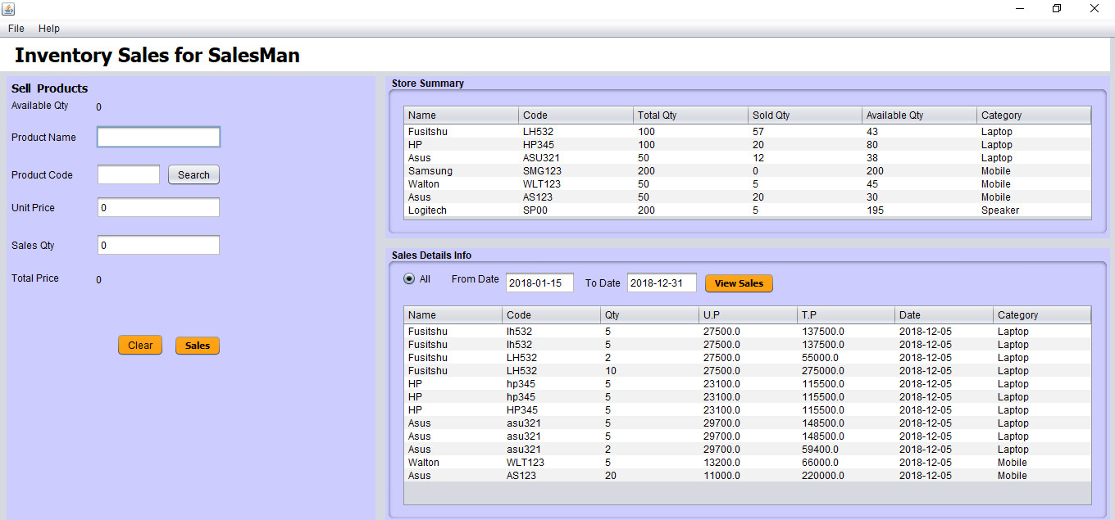
Continue…
After getting logged out the system is ready for any log in again. Here we log in as sales person to see the salesman views

Slide 16
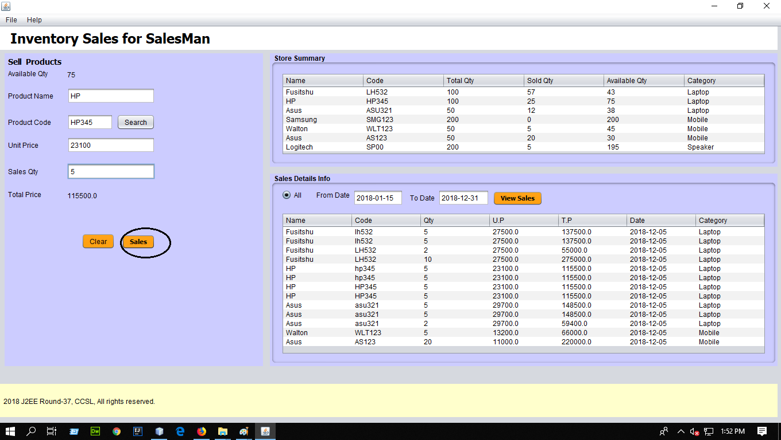
Continue...
Continue...

Slide 17
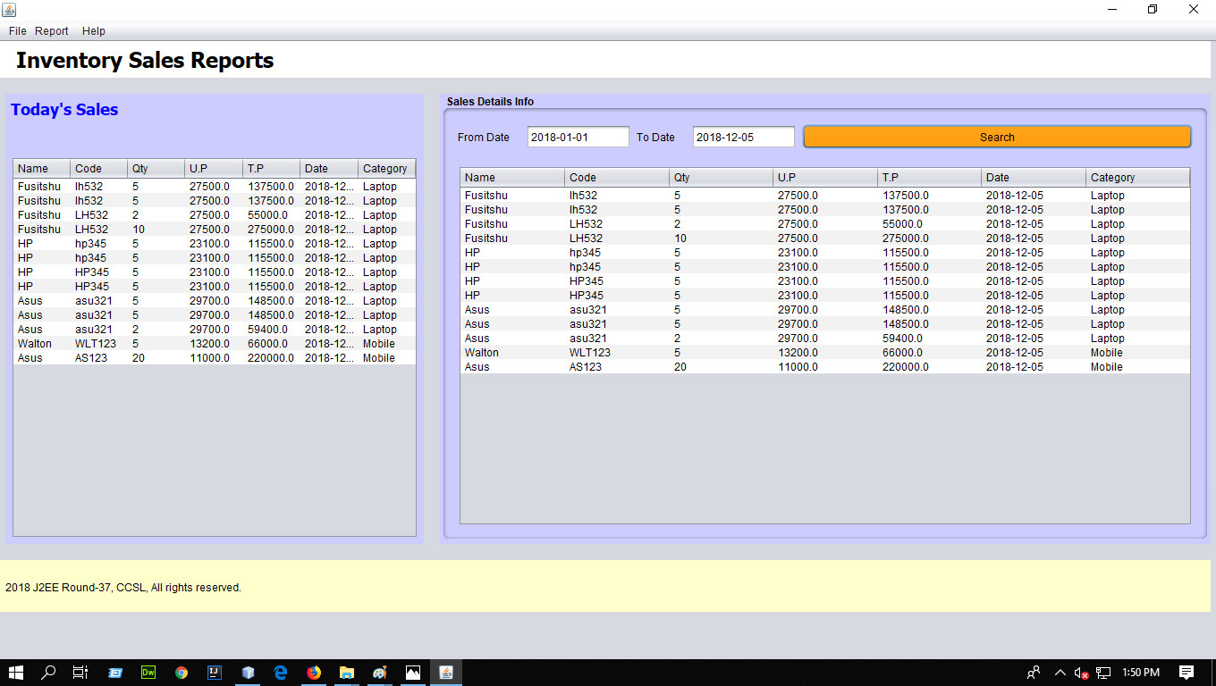
Continue…
Continue…

Slide 18
Continue…
From the menu bar a salesman can select option to see the sales summary

Slide 19
Continue…
From the file menu salesman can logged out from the system.

Slide 20
Conclusion
Thank you for watching

